Slide 1
Machine Learning Android Application FOR Image & Face Recognition
SUBMITTED BY: GUIDE INFO:
S.SUDHA MR.R.ROBIN JESUBALAN
J.UMASUDHA
A. RAMALAKSHMI
M.PATHMA PRIYA

Slide 2
ABSTRACT:
In this Project ,We Create TWO Android applications using the domain of Machine learning. They are,
1.Face Recognition App
2.Image RECOGNITION App
In the Face Recognition application, we will learn how to DETECT THE TWO FACE IN AN IMAGE IS SAME OR DIFFERENT.
In the Image Recognition App, if you show any fruit is it going to tell you which fruit it is. Similarly it can predict 1000 categories.
WE ARE using TensorFlow Lite AND Android Studio IN THIS PROJECT.

Slide 3
INTRODUCTION:
Now a days People travel across different places within & outside their country for their official purpose.
most of them are not familiar with others, so we must recognize the image and face.
In order to solve this problem, the app is created based on a Camera application.
At first, the user captures an image containing objects.
If it contains object is extracted using Machine Learning techniques.
If the object contains the face of a human then the emotions produced from face like happiness/sadness are also identified.
If the object contains the image of a any beings then size/shape of the animals or others are identified & guess the prediction of the image.

Slide 4
EXISTING SYSTEM:
The impact of this project is made by the existing system where Google Lens process the image into text, translate, navigate and search about the text.
The image is processed based on two major modules TEXT and IMAGE.
TEXT module contains translation, maps, related Images.
IMAGE module contains face emotions & image recognition.
Where face emotion detects a face and reveals one’s reactions such as happiness or sadness, etc.
This project is being developed using Android Studio with the Cognitive Services from Microsoft & Google API services.

Slide 5
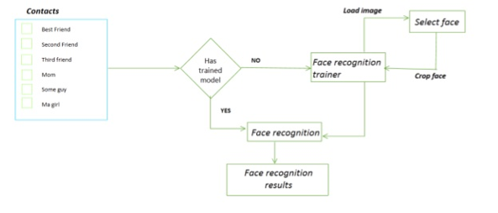
BLOCK DIAGRAM:

Slide 6
DEMERITS:
The background of the object also plays a significant role in Face detection.
The movement of head or different camera positions can cause changes of facial texture and it will generate the wrong result.
Change in facial expressions may produce a different result for the same individual.
Occlusion means the face as beard, mustache, accessories (goggles, caps, mask, etc.)

Slide 7
PROPOSED SYSTEM:
In the Face Recognition app, we learn how to COMPARE TWO FACES BASED On image using TENSORFLOW .
In the Image Recognition App, if you show the image of dog it was going to tell you the breed of dog
OR if you show any fruit is it going to tell you which fruit it is.
Similarly it can predict 1000 categories WITH THE USE OF Tensor Flow Lite .

Slide 8
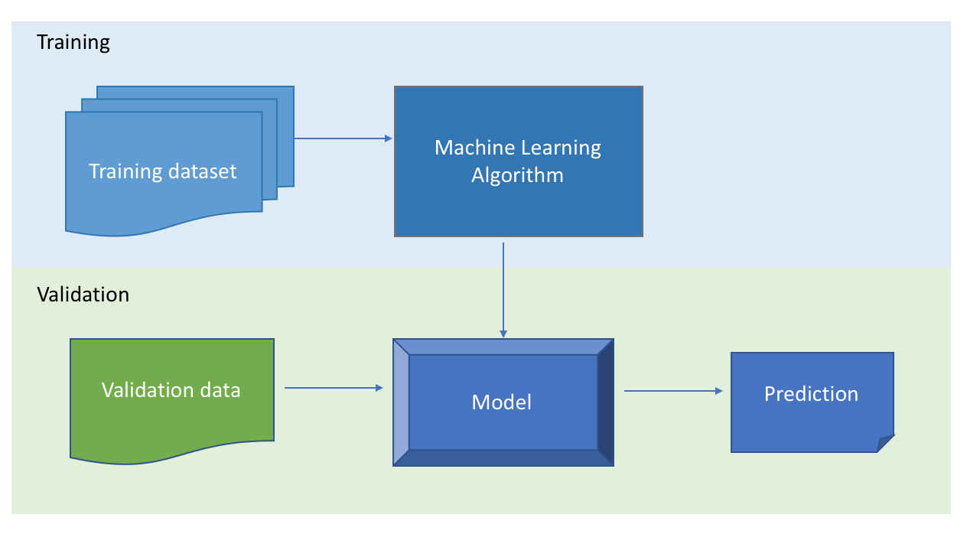
MAIN DIAGRAM:

Slide 9
MERITS:
Face detection API is used for the detection of faces in images and build contours of detected faces.
This feature is used only offline.
Using this API, users can extract faces from pictures and edit them using different filters.
Since TENSOR FLOW provides users with a possibility to apply face detection & IMAGE PREDICTION feature in real-time mode.
So if you need to develop face recognition app & IMAGE PREDICTION APP, you MUST USE THIS tensor-flow API, which has cleared image prediction.

Slide 10
MACHINE LEARNING:
ML is the study of computer algorithms that improve automatically through Experience .
Artificial intelligence is seen as a part of artificial intelligence.
ML algorithms build a model based on sample data, known as "training Data“.
A subset of ml is closely related to computational statistics, which Focuses on making predictions using computers.
Ml can perform tasks Without being explicitly programmed to do so.
For simple tasks assigned to Computers, it is possible to program algorithms telling the machine how to execute All steps required to solve the problem at hand.
on the computer's part, no learning Is needed.

Slide 11
APPLICATION OF MACHINE LEARNING:
Speech Recognition
Traffic prediction
Product recommendations
Self-driving cars
Email Spam and Malware Filtering
Virtual Personal Assistant
Online Fraud Detection

Slide 12
FACE RECOGNITION:
Face is our primary focus of interaction with society, face communicates identity,emotion,age.
it is also quite useful for judging gender,size,shape and perhaps some of the characteristic of the person.
Human brain is trained for face detection and face recognition.
Face recognition is the task of identifying an already detected face as a Known or unknown face , and in more advanced cases(Telling exactly who is it?)
It is based on features like distance between the eyes, width of the nose,cheekbones,Depth of the eye shocket.

Slide 13
APPLICATION OF FACE RECOGNITION:
Reporting duplicate voters in India.
Passport and visa verification & driving license verification can also be done using this technology.
In defence ministry, airports, and all other important places the technology can be used to ensure better surveillance and security.
It can also be used during examinations such as Civil Services Exam, SSC, IIT, MBBS, and others to identify the candidates.
For access control verification and identification of authentic users it can also be installed in bank lockers and vaults.
For identification of criminals the system can be used by police force also.

Slide 14
IMAGE RECOGNITION:
Image recognition is the process of identifying and detecting an object or a feature in a digital image.
A digital image is a representation of a 2D image using a finite set of digital values for each pixel.
The digital values of this pixels are processed and used in image recognition and in other areas of image processing.
Image prediction is the one of the term in image processing which is used for predict the similar prediction In the picture/photos/image.

Slide 15
APPLICATION OF IMAGE RECOGNTION:
Advances in image processing and artificial intelligence
will involve,
translating languages,
recognizing and tracking people and things,
diagnosing medical conditions,
performing surgery,
reprogramming defects in human DNA,
automatic driving all forms of transport,
spoken commands

Slide 16
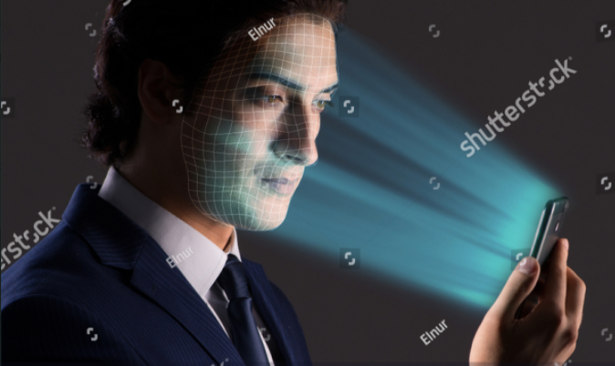
REQUIREMENTS:
SOFTWARE:
ANDROID STUDIO
TENSORFLOW LITE
LANGUAGE:
JAVA
XML
HARDWARE:
CAMERA
MEMORY

Slide 17
TENSOR FLOW:
Tensor Flow is a free and open-source software library for machine learning. It can be used across a range of tasks.
Tensor flow is a symbolic math library based on dataflow and differentiable programming.
It is used for both research and production at Google.
Tensor Flow was developed by the Google Brain team for internal Google use.
Tensor Flow is available on 64-bit Linux, macOS, Windows, and mobile computing platforms including Android and iOS.
Its flexible architecture allows for the easy deployment of computation across a variety of platforms like CPUs,GPUs,etc….

Slide 18
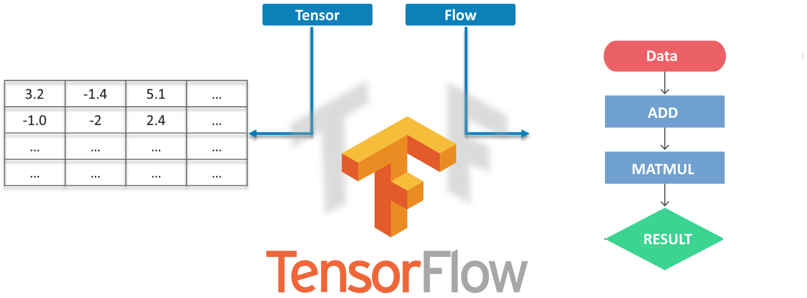
BLOCK DIAGRAM:

Slide 19
ANDROID STUDIO:
Android Studio is the official integrated development environment (IDE) for Google's Android operating system,
Built on Jet Brains' IntelliJ IDEA software and designed specifically for Android development.
It is available for download on Windows, machos and Linux based operating systems or as a subscription-based service in 2020.
It is a replacement for the Eclipse Android Development Tools (E-ADT) as the primary IDE for native Android application development.
Android Studio supports all oops based programming languages like Java, C++,kotlin.

Slide 20
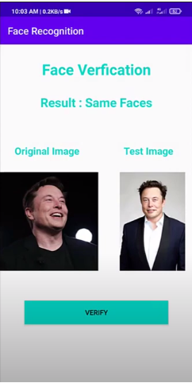
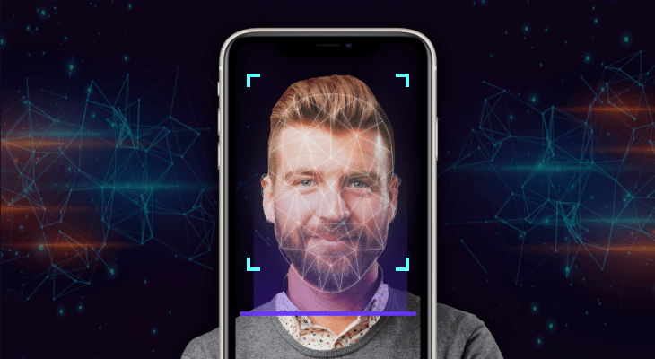
RESULT 1:

Slide 21
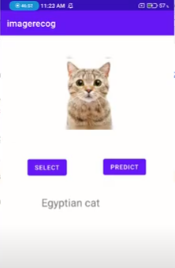
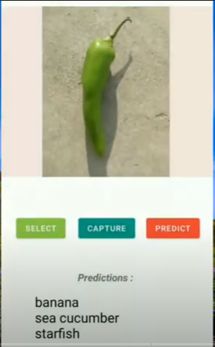
RESULT 2:

Slide 22
CONCLUSION:
In this Project, Android applications of image and face recognition using the domain Of Machine Learning is developed.
In the Face Recognition application, we was Learn how to compare Two Faces in an Image and detect the face in the image is Same or Different.
In the Image Recognition App, if you show the image of dog it Is going to tell you the breed of dog or if you show any fruit is it going to tell you Which fruit it Is.
Similarly it can predict 1000 categories which is using Tensor Flow Lite & Android Studio.

Slide 23
THANK YOU

